Slide 1




Login
Let’s figure it out together.
Sign Up
(c) The StudyBuddy Team
Privacy Policy | Contact Us | Our Team

Slide 2
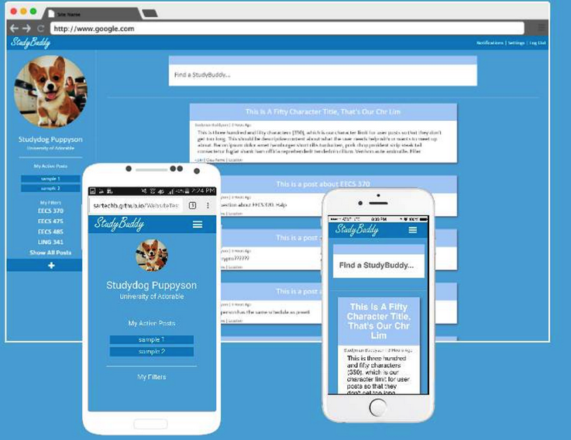
Login
Stop Working Alone
StudyBuddy is a simple social platform that helps you discover opportunities to collaborate with students near you. It's designed to take stress off of you when courses get challenging by working with others. We believe that working together lets us work better - no matter what we're doing.
Sign Up
Would be gray
(c) The StudyBuddy Team
Privacy Policy | Contact Us | Our Team

Slide 3
Login
Meet New People
Work Smarter
StudyBuddy is perfect for meeting new people in your class. Get together and work on anything from projects to test preparation.
There’s a lot of help out there, but how fast can you get what you need from a book? Sharing knowledge helps you learn faster.
Why?
THIS SLIDE NEEDS REDESIGN
Keep it Relevant
Get Un-Stuck
Don’t like clutter? Us either. We have tools to help you find what’s relevant to you and leave out the other stuff. Stop searching and start getting the help you need.
Being stuck is no fun. It happens to the best of us. When one head isn’t enough, we help you find a new, fresh perspective and keep you productive.
Sign Up
(c) The StudyBuddy Team
Privacy Policy | Contact Us | Our Team

Slide 4

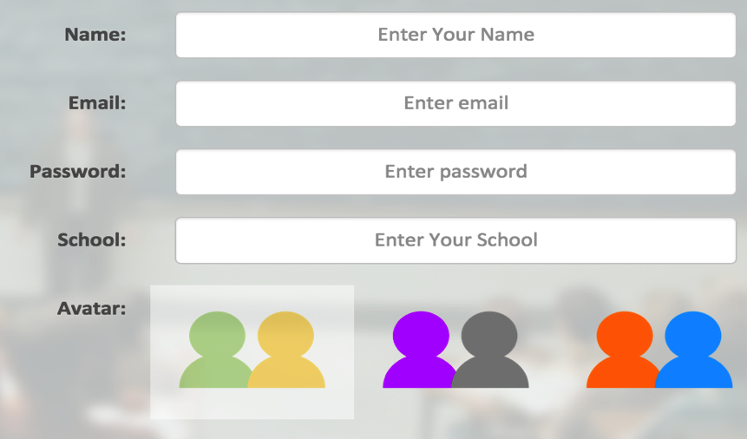
Home | Our Team | Login
Login
So what are you still waiting for?
It’s free to sign up and takes just a minute – stop struggling by yourself and get a StudyBuddy!
THIS SLIDE NEEDS REDESIGN
Sign Up
(c) The StudyBuddy Team
Privacy Policy | Contact Us | Our Team

